Slide 1
Royal Ballet and Opera
Work With Us

Slide 2

Thinking about a career in the arts?

Slide 3

Information Pack for Candidates

Slide 4
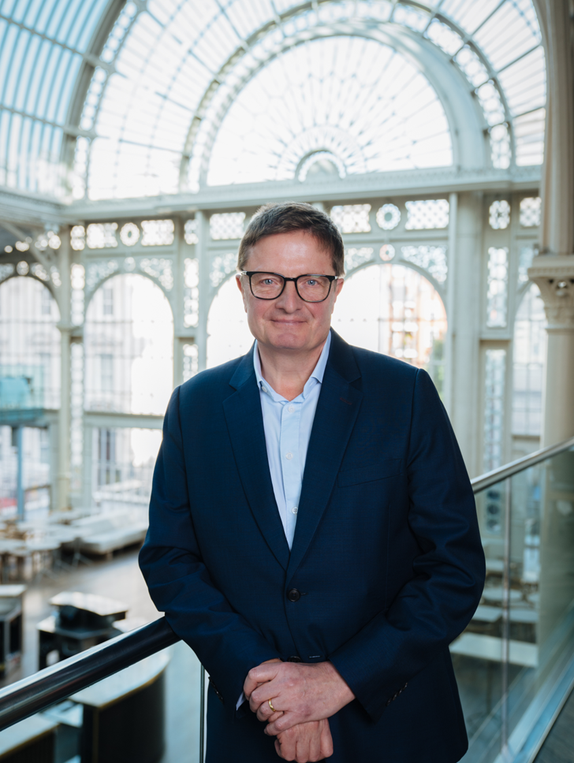
Welcome
MESSAGE FROM ALEX BEARD, CHIEF EXECUTIVE
Thank you for taking the time to apply for a role with the Royal Ballet and Opera.
Extraordinary, world-class performances of opera and ballet are at the absolute heart of our vision here.
So, whether the audience is in one of our beautiful theatres in Covent Garden, watching around the globe in cinemas and online streaming, or taking part in learning and participation programmes up and down the country, we want as many people as possible to enjoy and appreciate these astonishing artforms.
None of this would be possible without the exceptional team of people who work here. People are centre stage of everything we do at RBO, and we built our culture on our core values: treating everyone with Respect, being Open in our mindset and approach, and striving for the Highest Standards in everything we do.
Everyone is welcome at RBO, whatever your background or experience, and we look forward to your application.
Best of luck!
Alex

Slide 5
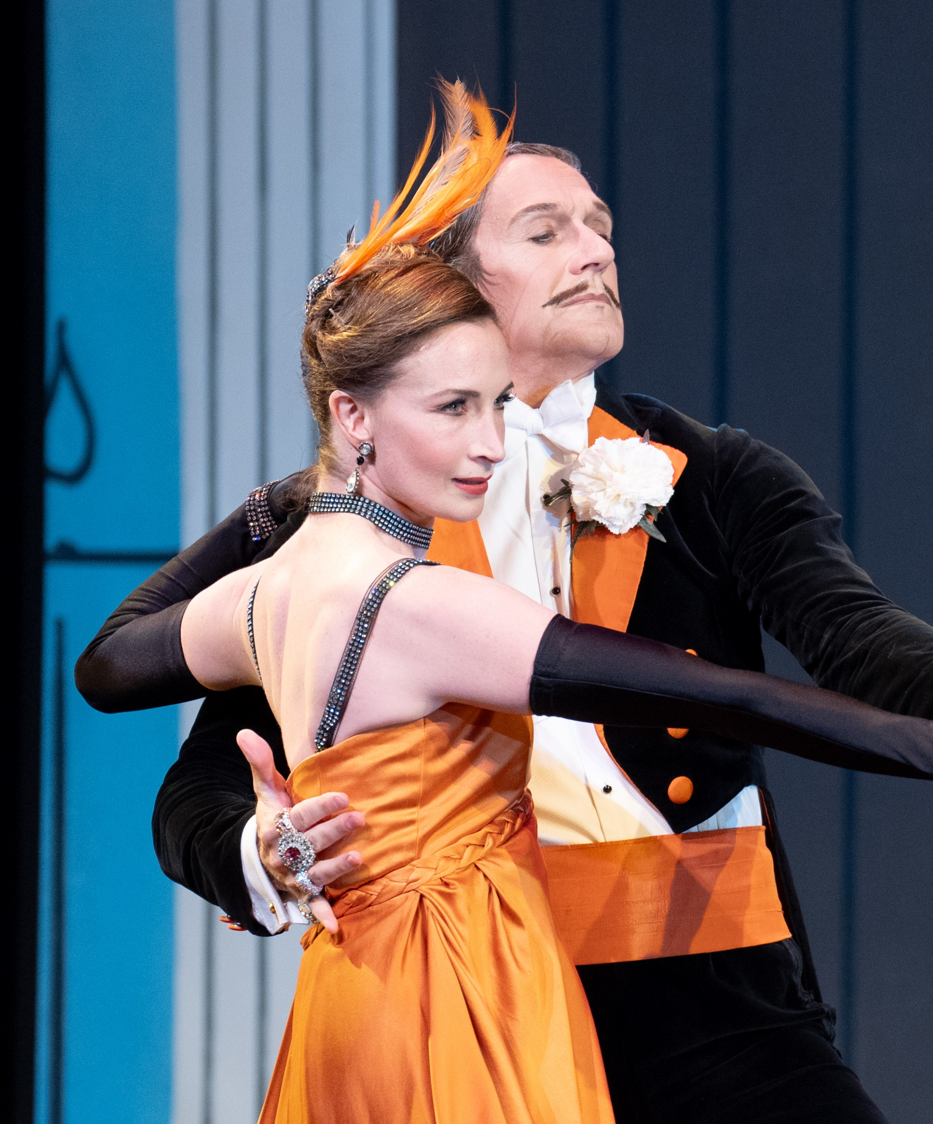
About Us
Home to The Royal Ballet, The Royal Opera and the Orchestra of the Royal Opera House, the Royal Ballet and Opera (RBO) brings together world-class performers and trailblazing creative teams to share unforgettable performances with audiences near and far.
We house the busiest theatres in the world, delivering more than 400 performances and around 1,350 learning events each year. We employ 1100 permanent staff and generate a turnover of £135m, attracting 1.5m attendances in Covent Garden and in cinemas.
We’re at the forefront of innovation in ways in which audiences can experience opera and ballet. Our work is accessed and experienced across the UK and globally through streams, tours, cinema relays, radio broadcasts and TV output.
We work across three sites, all enabling us to produce exceptional performances – our theatres and offices at Covent Garden, our production workshop at Thurrock and our storage facility at Aberdare.

Slide 6
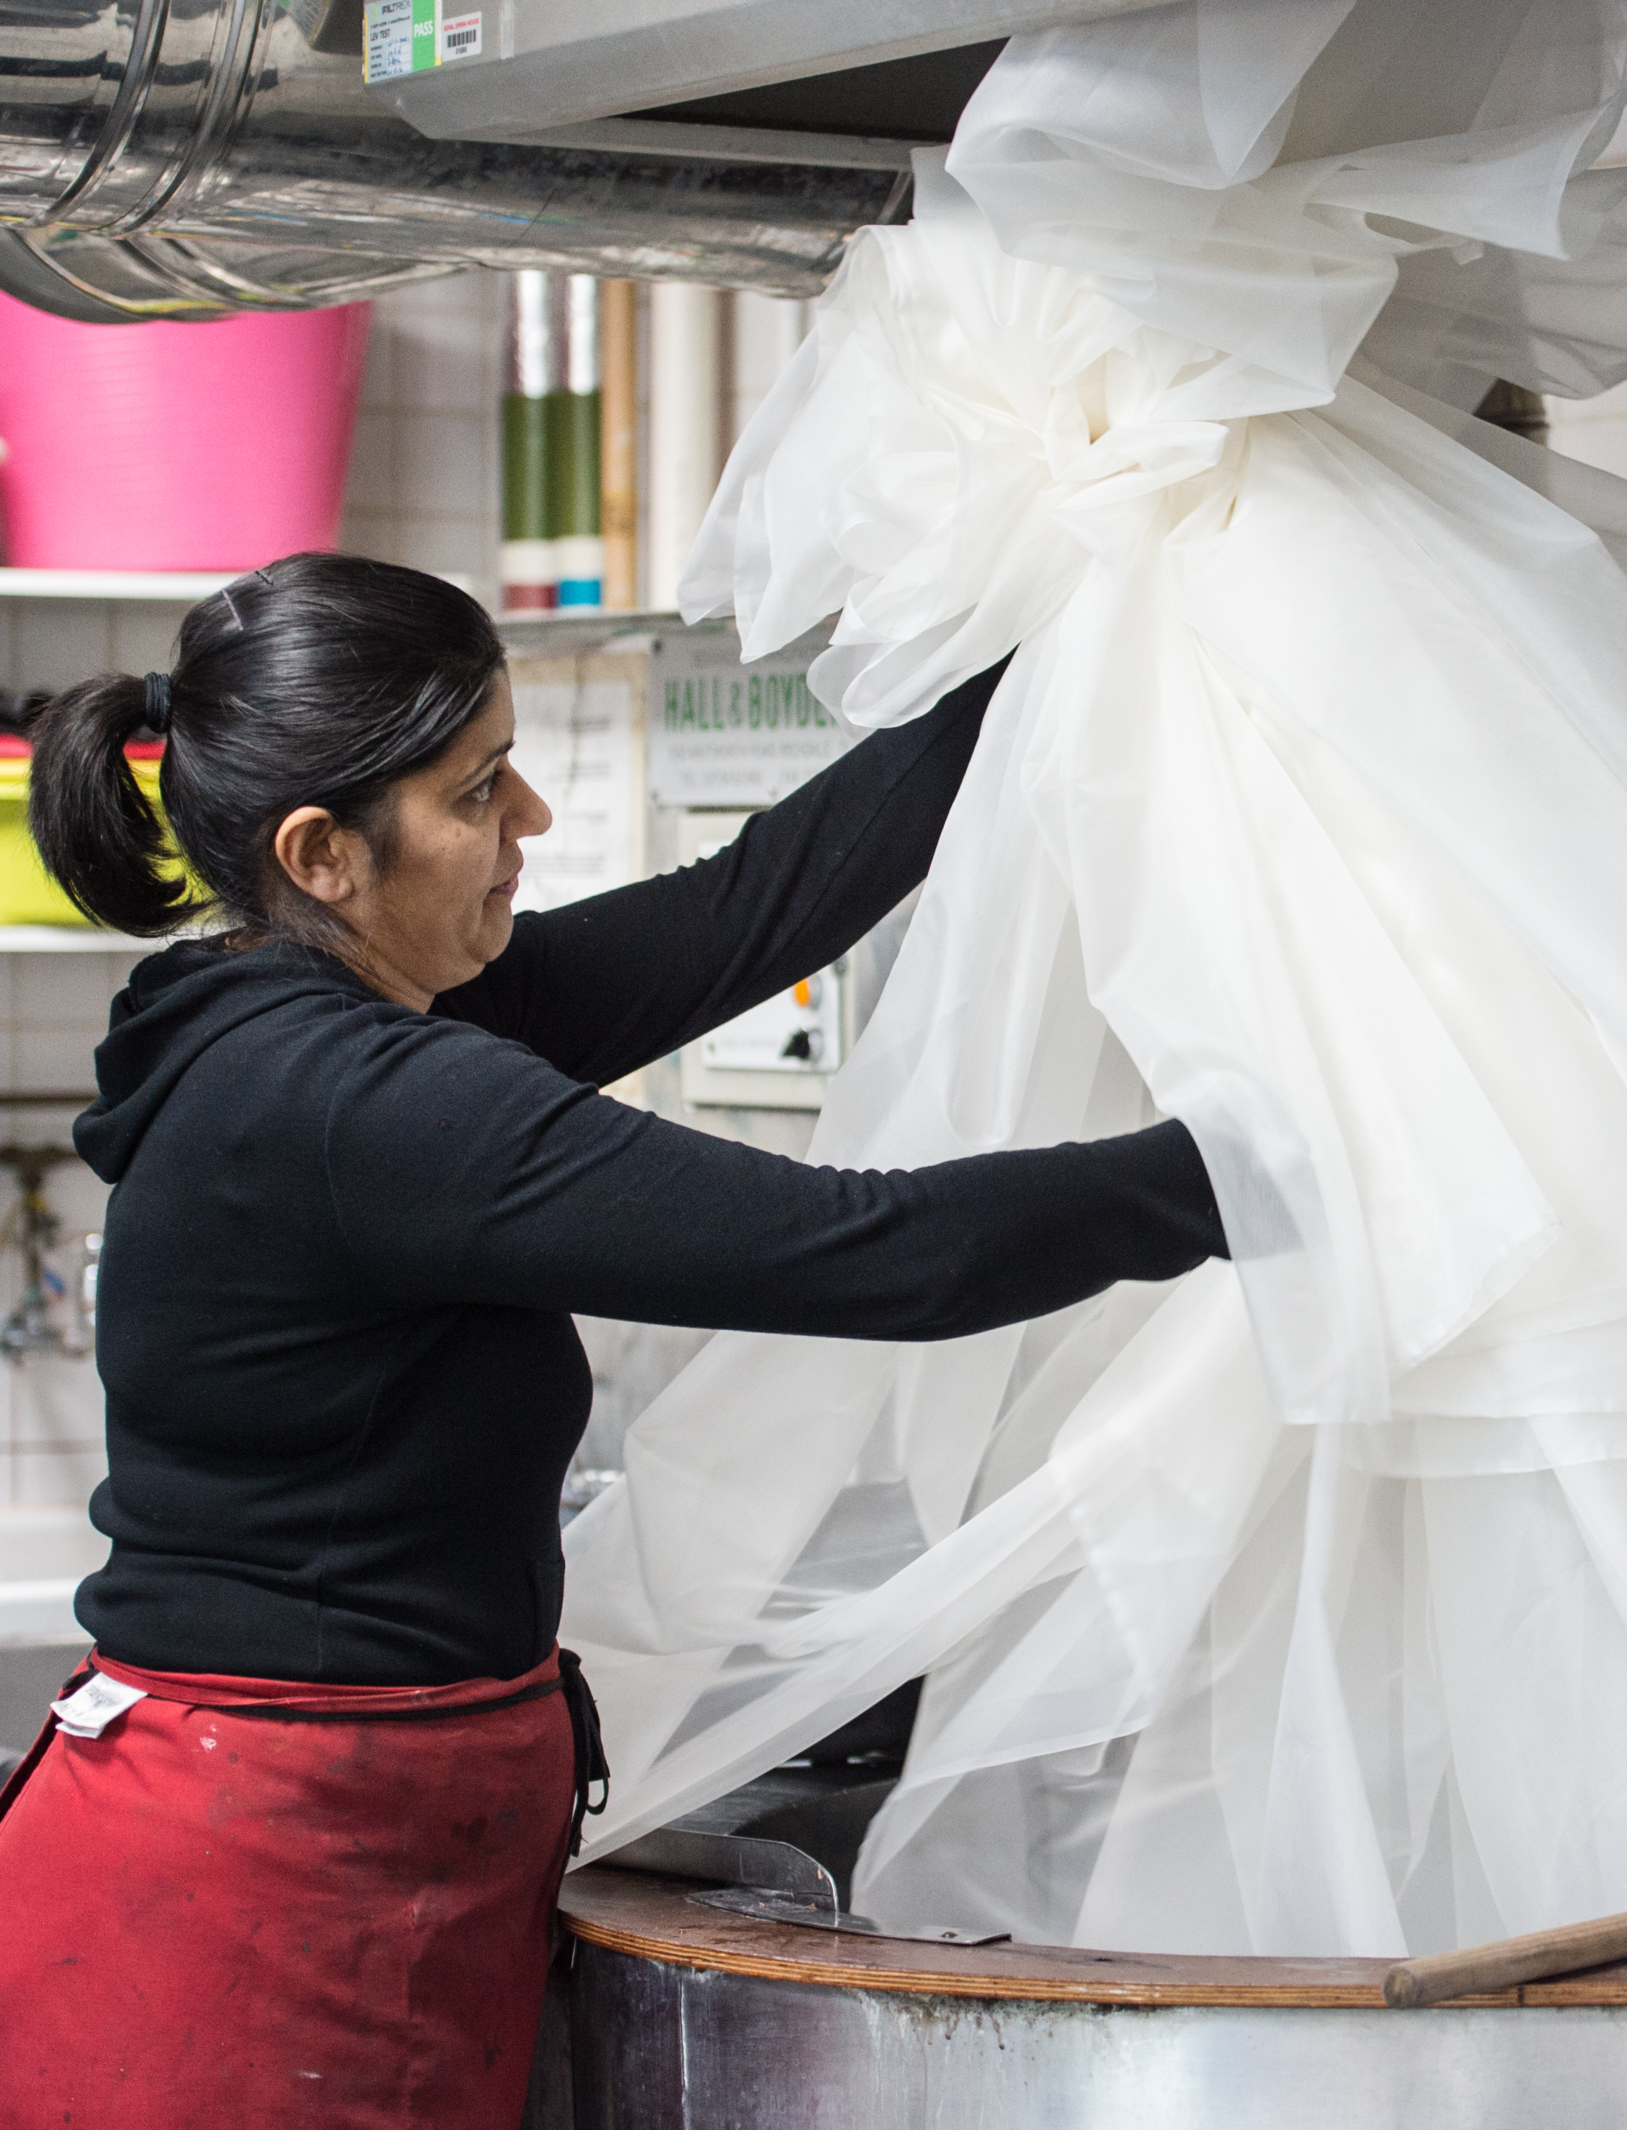
Work For Us – Everyone Is Welcome
We want many more people to enjoy and engage with exceptional ballet and opera.
We believe diversity is about making sure we can attract and develop talented people who bring more because of their different backgrounds, experiences, cultures and outlooks.
Recruiting and working with these talented people is just part of the work. We are committed to creating an environment where everyone believes they belong and can do their best work.
We operate a fair and open recruitment and selection process. Every role is open to all sections of society, and we welcome your application, regardless of your sex, race, religion or belief, ethnic origin, different physical ability, age, gender identity or sexual orientation.
We particularly welcome applications from those who are from a global majority background and/or those who are disabled, as they are under-represented within the Royal Ballet and Opera. As a Disability Confident employer, we guarantee to interview all disabled applicants who meet the essential minimum criteria for our vacancies.

Slide 7
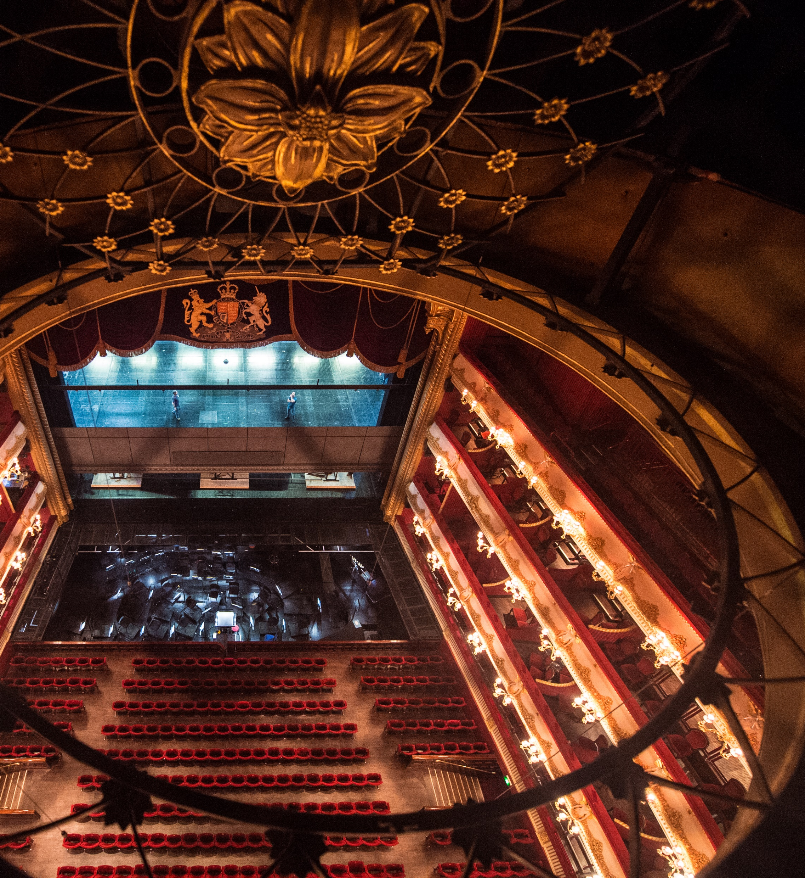
Work With Us – What to Expect
Starting a new job can be daunting. At the Royal Ballet and Opera, we want to make that transition as smooth and easy for you as possible. We’ll provide you with all the information you need before you start and will be on hand to answer any questions you may have about the role.
We are a big organisation, with more than 1100 staff and sites at Covent Garden, Thurrock and Aberdare. There will be plenty of people to meet and you’ll have a structured induction, including tours of both our Covent Garden and Thurrock sites. This is a great way to orient yourself and understand how all the work comes together.

Slide 8
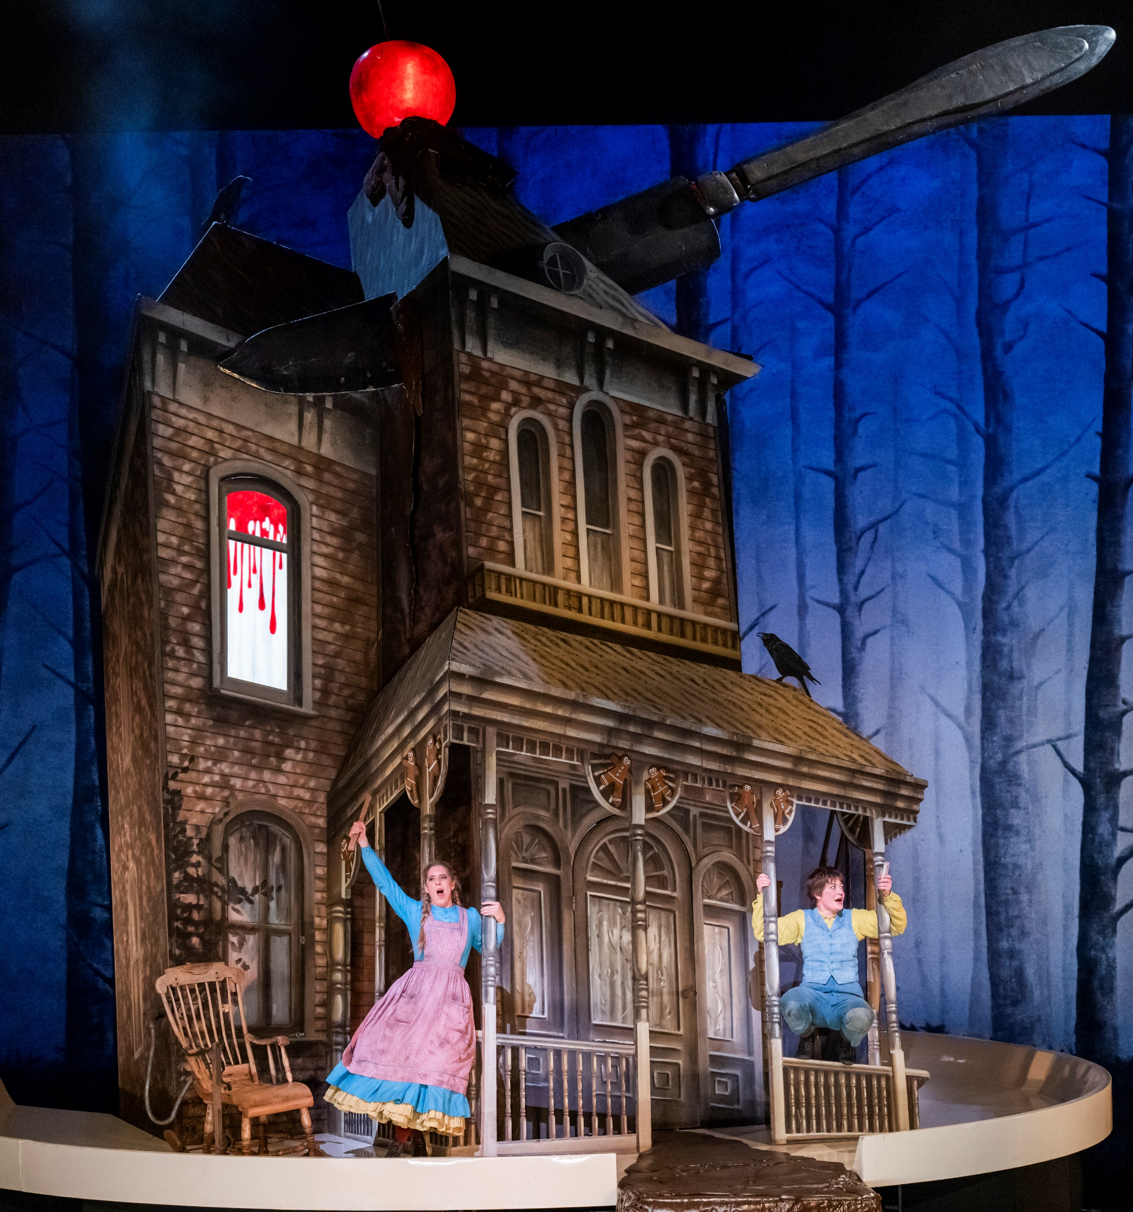
Staff Benefits
33 days annual leave (including bank holidays)
Membership of the ROH Pension scheme
Staff offers on performance tickets and access to general rehearsals
Subsidised canteen and coffee bar
Interest free season ticket loan once you have passed your probation and onsite spaces for secure cycle storage, subject to availability
Family Friendly policies
Access to our Employee Assistance Programme providing 24-hour advice and counselling services
Access to the Benevolent Fund, providing confidential support and assistance
Special arrangements for Healthcare including a health cash plan for employees and healthcare support for performers
Discounts on alternative and physical therapies provided in-house
Discounted staff ballet, Pilates and yoga classes
Discounts at the ROH Shop
Concessions at a wide range of local Covent Garden shops, restaurants and gyms

Slide 9

We await your application
hr.recruitment@roh.org.uk

